Slide 1
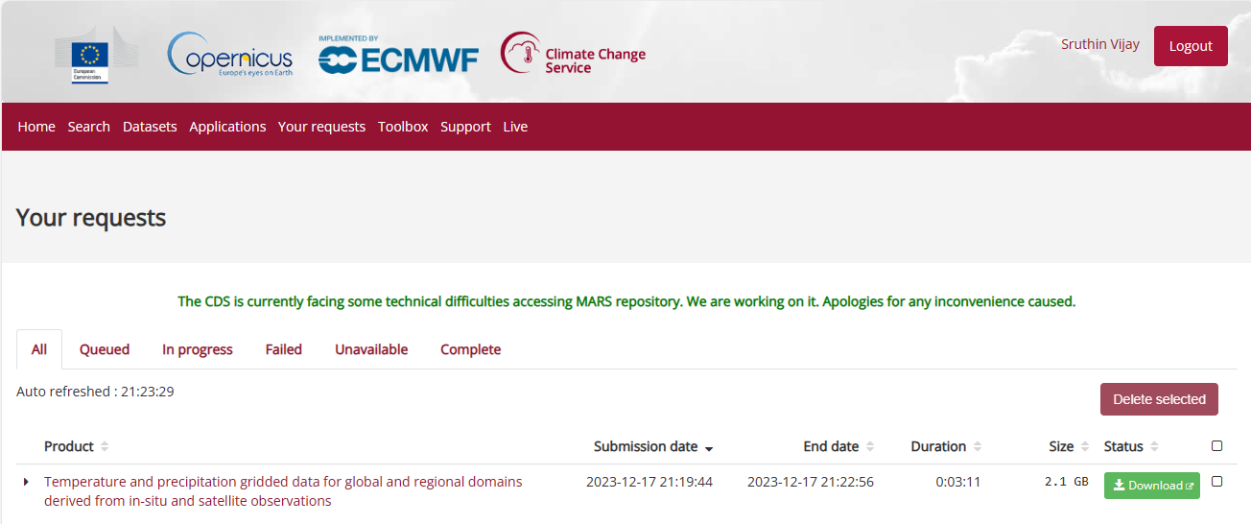
SKILL ASSESSMENT TEST - EQUINOCT
Step 1: Data Collection via COPERNICUS DATA STORE
Data Downloaded with following parameters.
Origin: Imerg
Region: Global
Variable: Precipitation
Temporal Resolution: Daily
Spatial Resolution: 0.5 X 0.5 degree
Year: 2018 To 2021
Version: V6.0

Slide 2
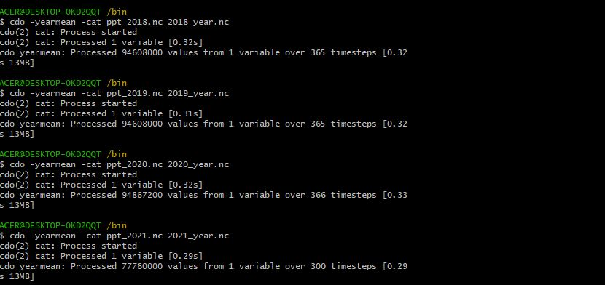
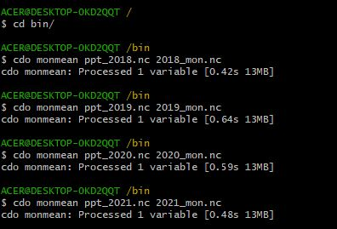
SKILL ASSESSMENT TEST - EQUINOCT
Step 2: Data Processing
Input for yearly avg. precipitation heatmaps
Input for monthly timeseries plot
I have used CDO commands via Cygwin terminal to obtain yearly mean with a single command from the daily precipitation data.
I have used CDO commands via Cygwin terminal to obtain monthly mean with a command from the daily precipitation data.
Command: cdo –yearmean –cat input.nc output.nc
Command: cdo monmean input.nc output.nc
Output files from CDO are visually verified and analyzed by plotting in ArcGIS software.

Slide 3
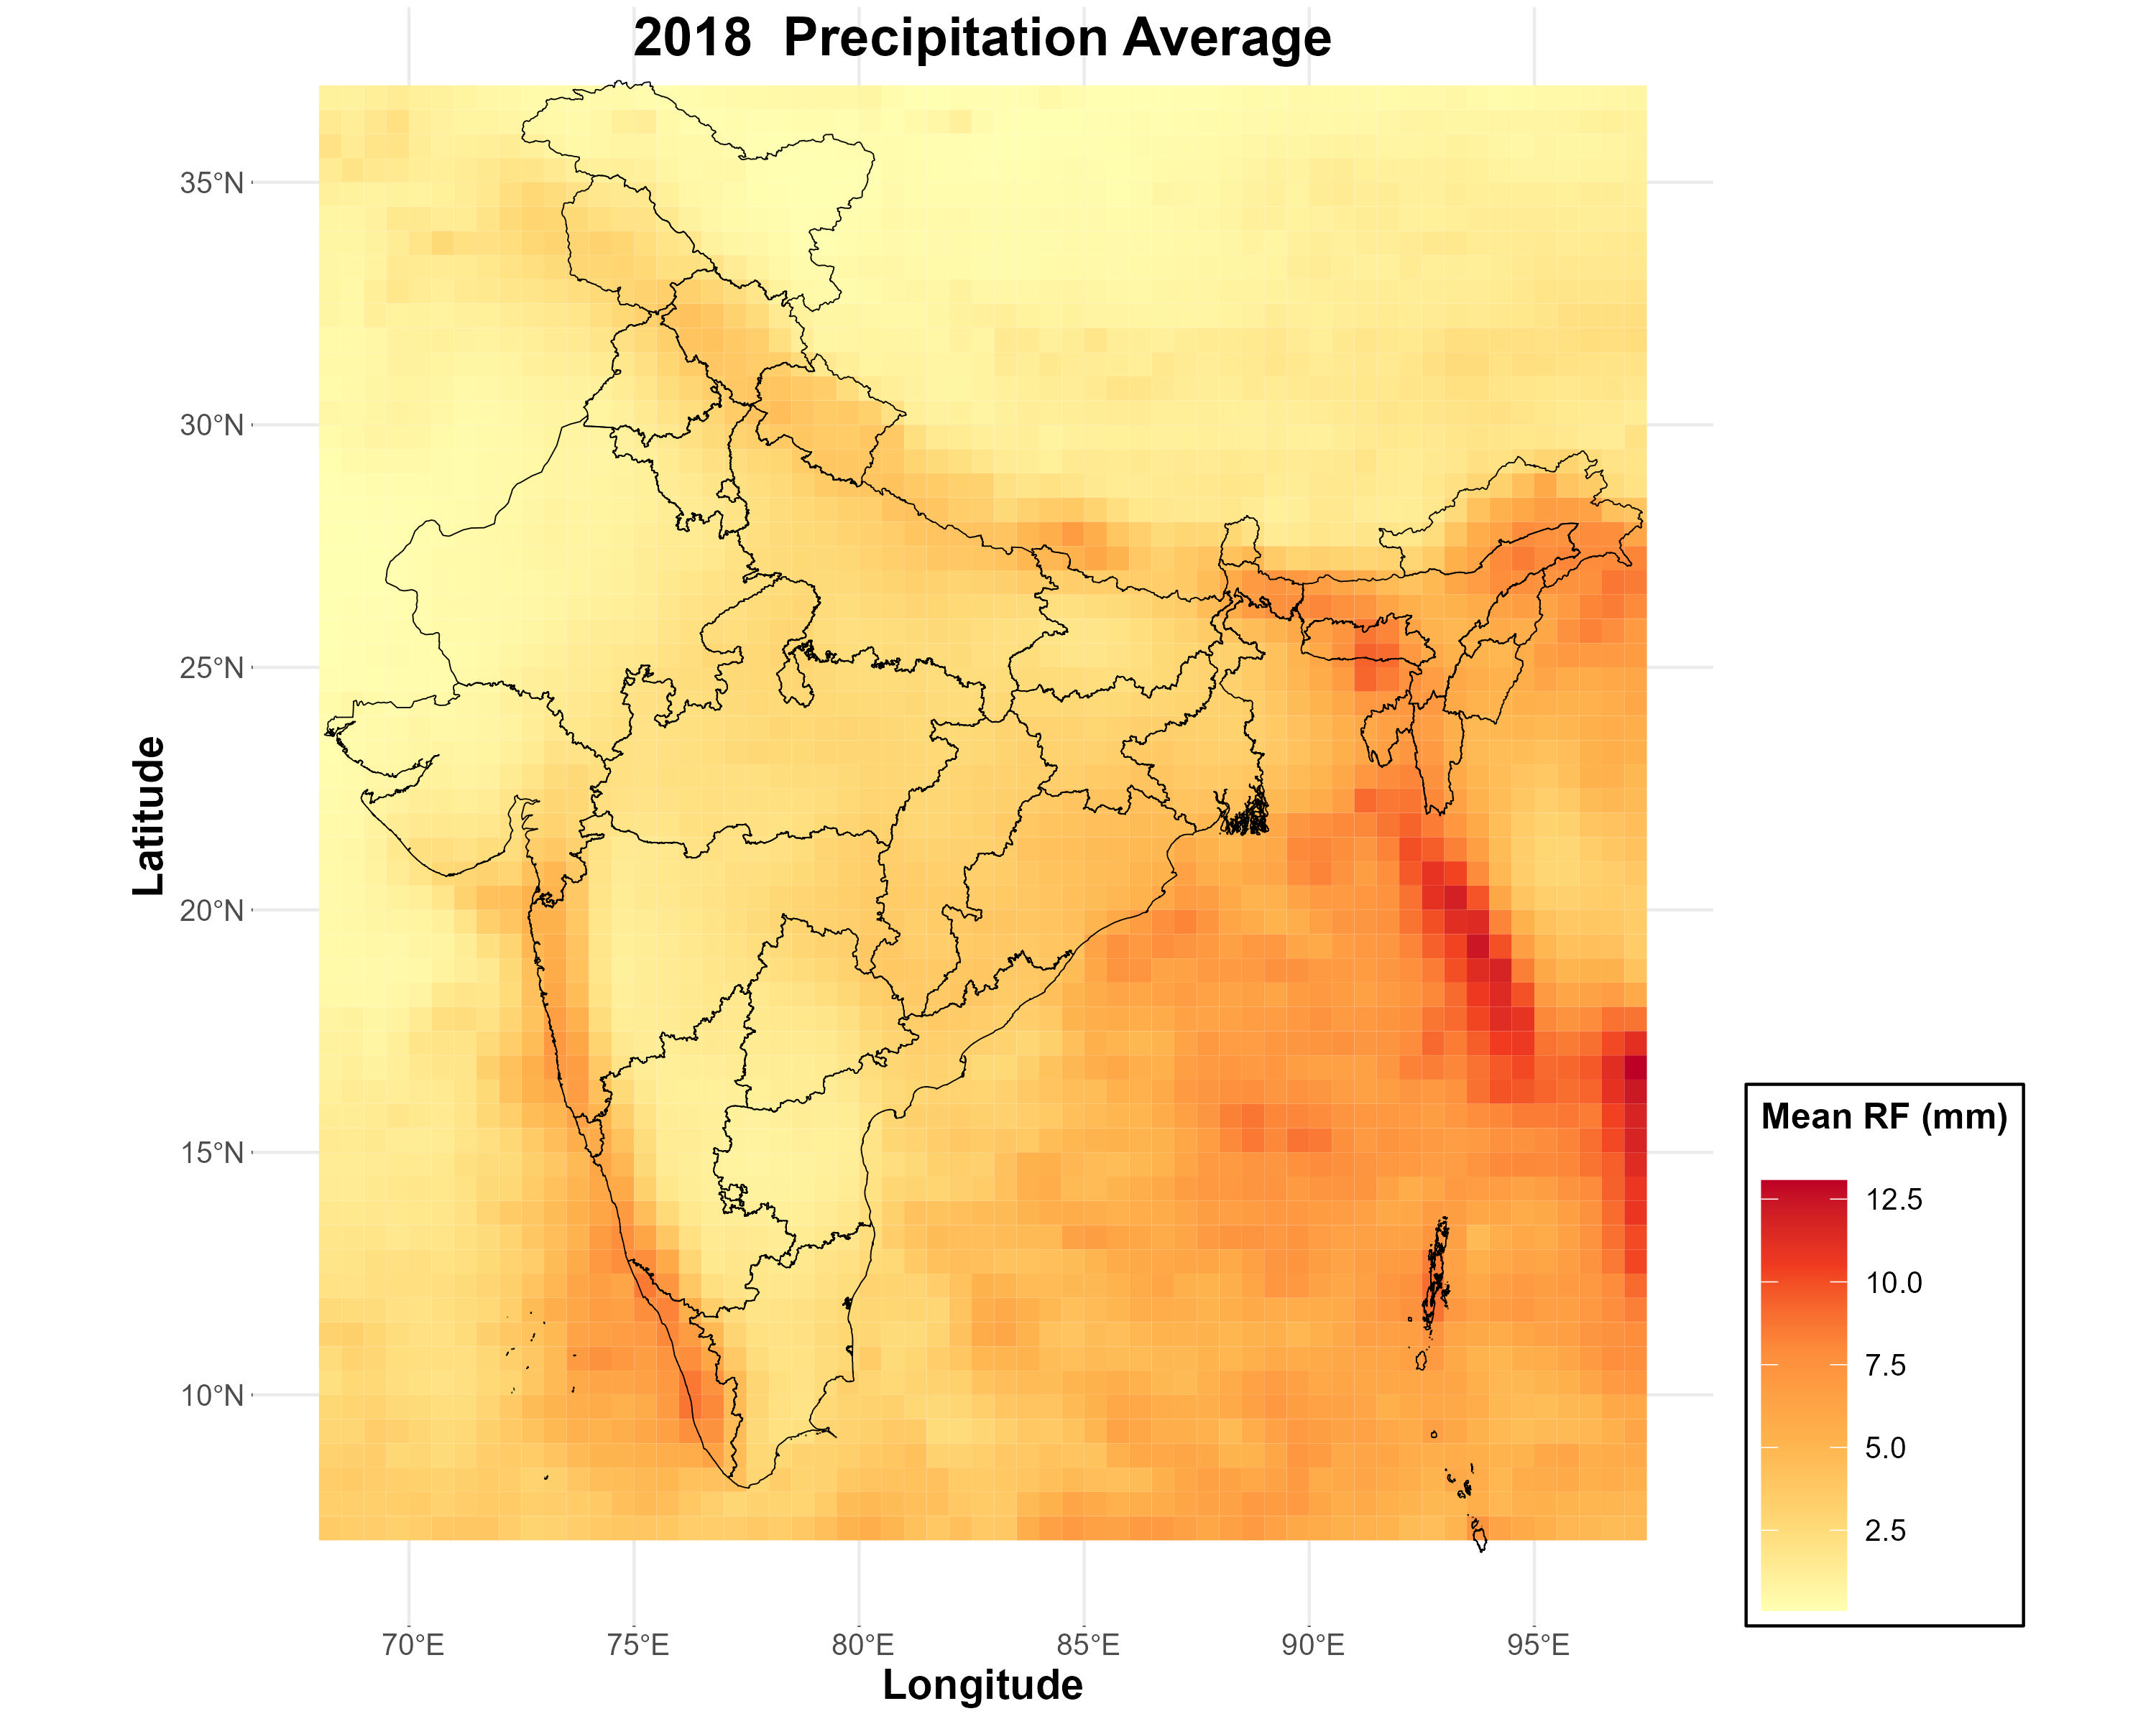
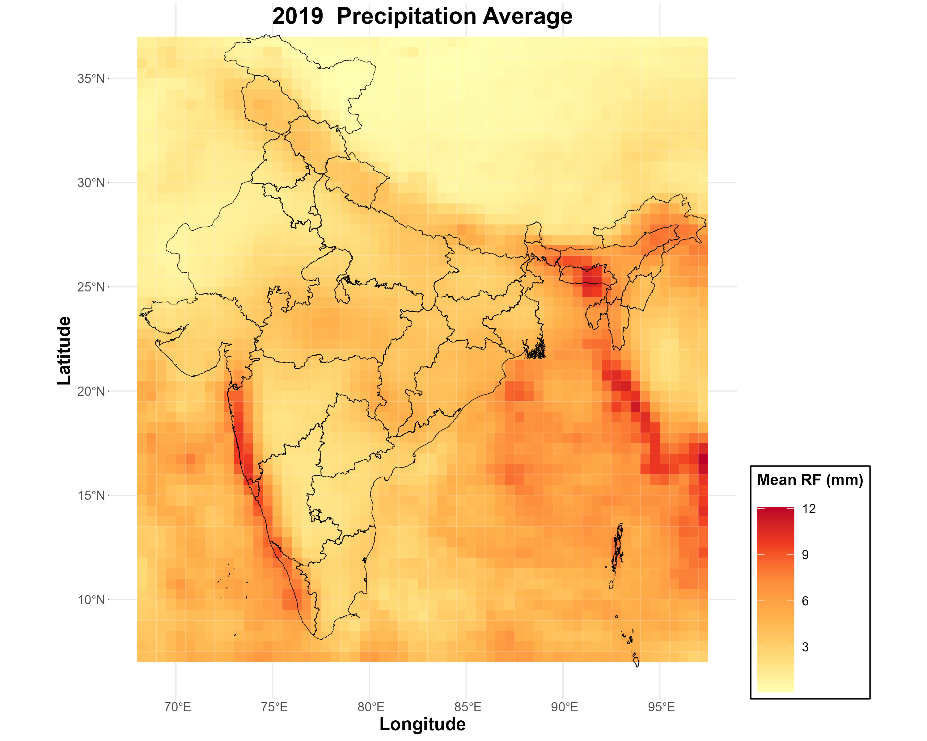
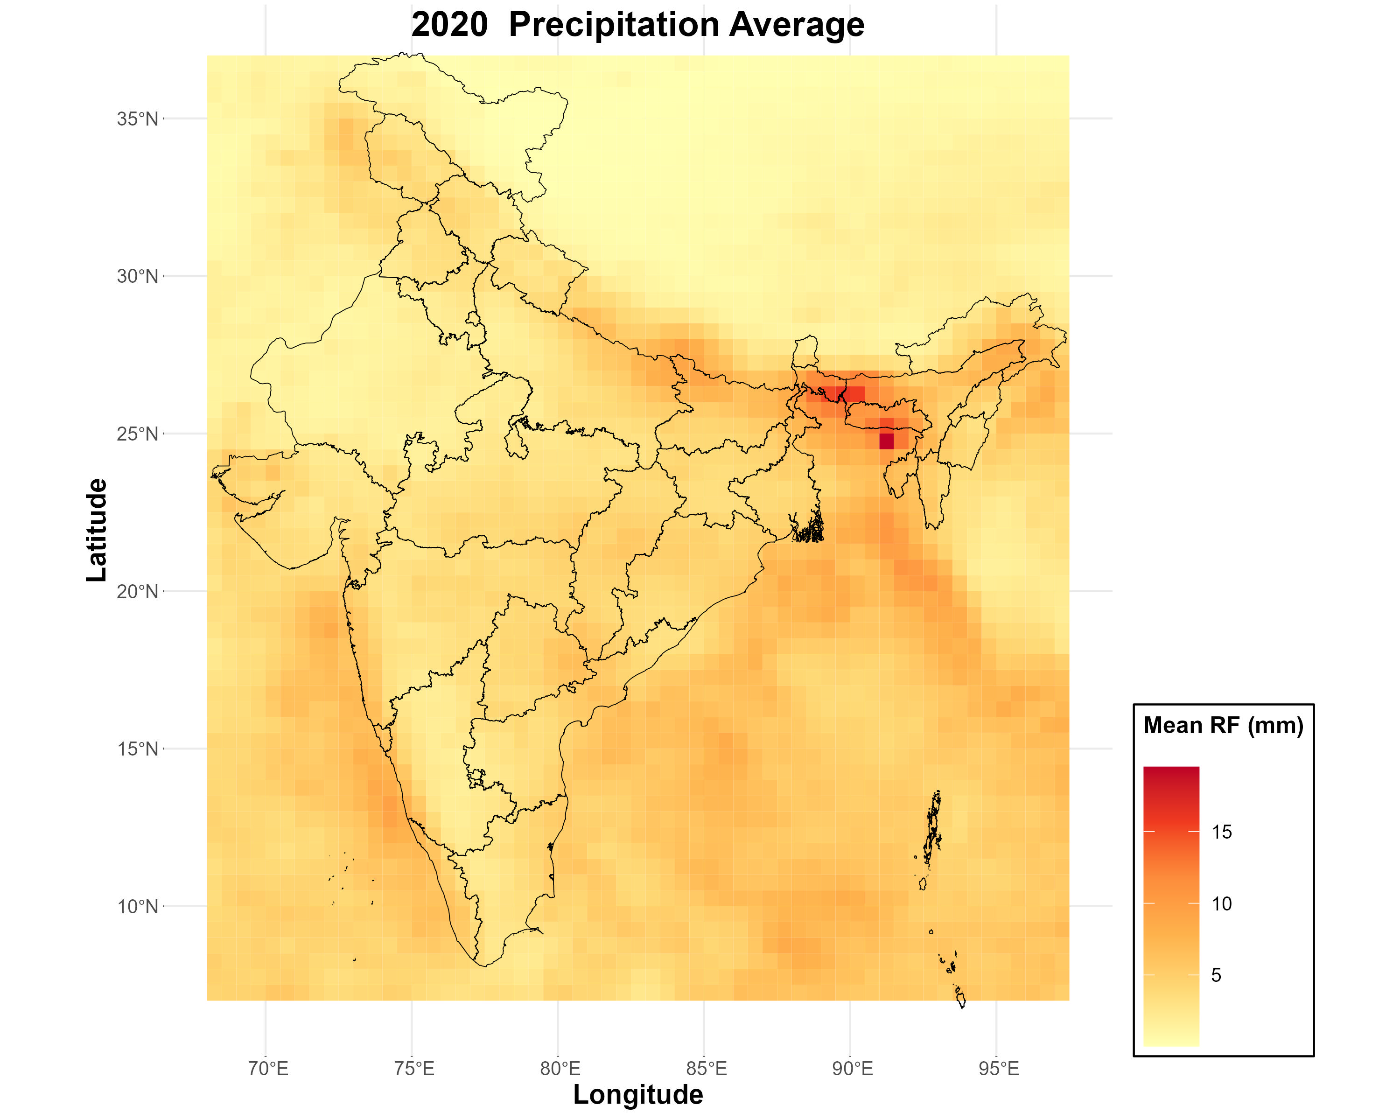
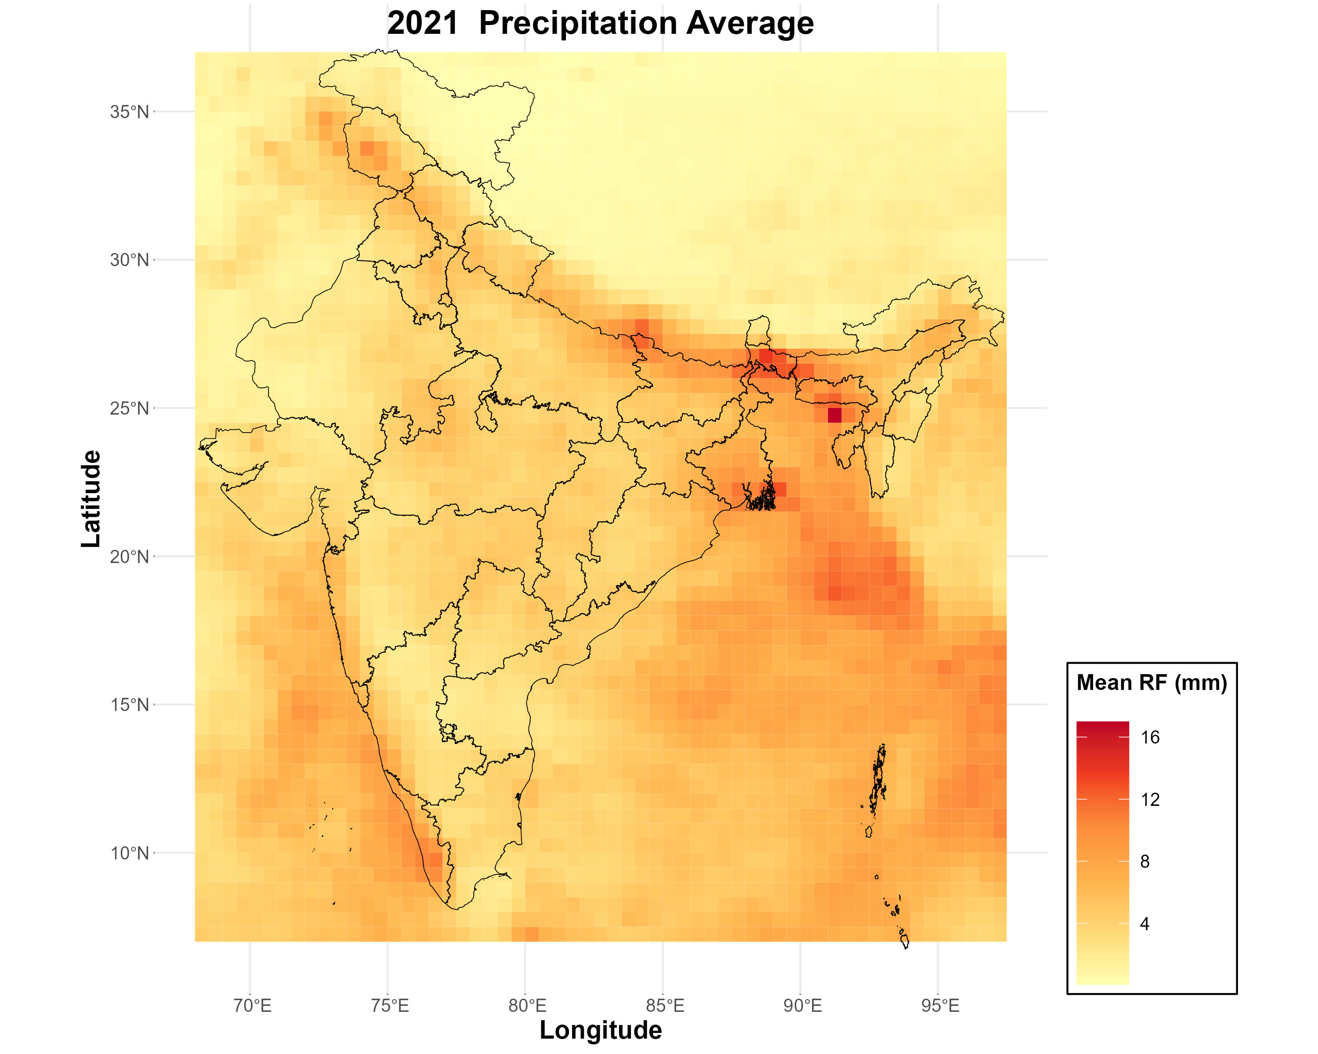
SKILL ASSESSMENT TEST - EQUINOCT
Objective 1: Heat maps of yearly precipitation data
R programming is used to plot the yearly mean of precipitation (code shared in github)
Steps
Indian domain is cropped using R programming (code shared in github)
Using the yearly mean computed using CDO, Heat maps are plotted using R.

Slide 4
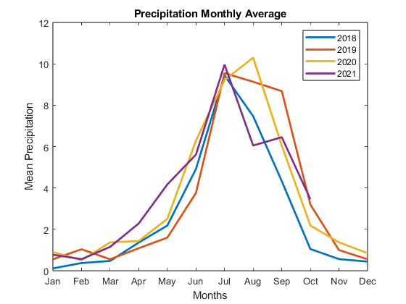
SKILL ASSESSMENT TEST - EQUINOCT
Objective 2: Time series graph with monthly averages in a timeline
Time series is plotted using Matlab code (code in github), where input file is the monthly file extracted using CDO command

